Slide 1
DevOps: Today, The Future…
Naing Ye Minn
Myanmar Open Source Community
#MOSC

Slide 2
What is DevOps?

Slide 3
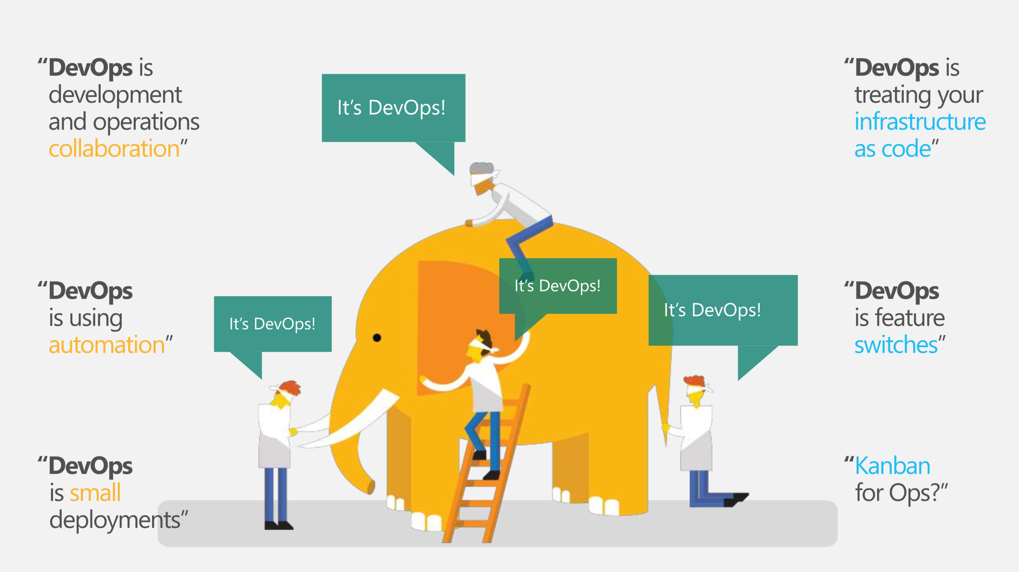
Image Credit: technet.microsoft.com

Slide 4
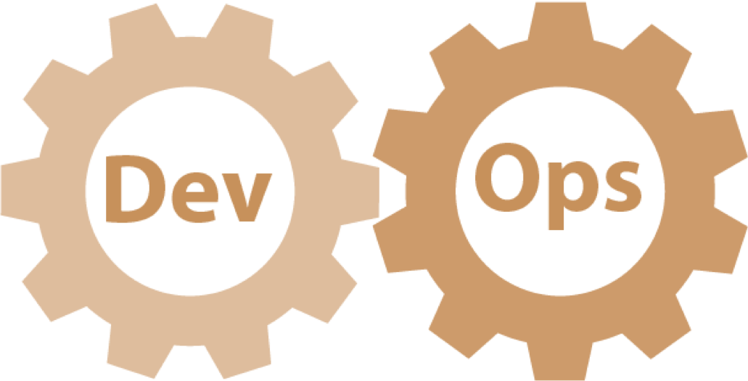
Definition
DevOps (clipped compound of “Development” and “Operation”) is a culture, movement and practice that emphasize the collaboration and communication of both software developers and other information technology professionals while automating the process of software delivery and Infrastructure change

Slide 5
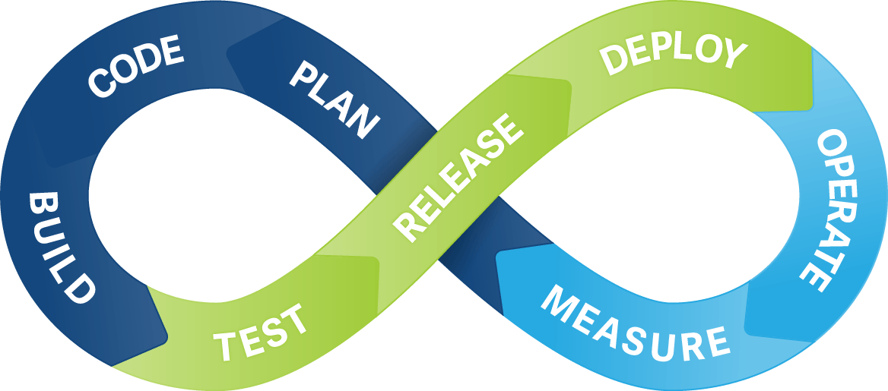
Typical Dev & Ops Cycle

Slide 6
Roles of Dev and Ops
Dev - Create Change - Add or Modify Features
Ops - Create Stability - Create or Enhance Services

Slide 7

Conflict of Interests
My App is working fine in our development environment!
It’s not my server problem! It’s your code!
Image Credit: www.independent.co.uk

Slide 8
Everyone has a need, just they don’t align together
Business
We want to provide this Service to customers already!
I want this feature hit the market soon!
I want pattern recognizing for this time series data! Now!
Development
I want to develop this, change codes and test.
I want to release this feature today.
I want to try this new tool and setup.
I want control over my deployment! My code! My way!!!
Operations
We need stable infrastructure! We need stable environment!
What?! Server is slow after your new release? And you think that’s the server problem?
You want to deploy your new code today? To production? What are you talking about?

Slide 9
Goals of DevOps
People
Culture Change. More collaboration. Better transparency. Enforce people to assume accountability. Better Communication is demanded.
Technology
More responsive to business needs. Faster Go-To-Market. Improve quality of works. Better control yet more flexible.
Process
Faster release and deployment cycles. More Agile.

Slide 10
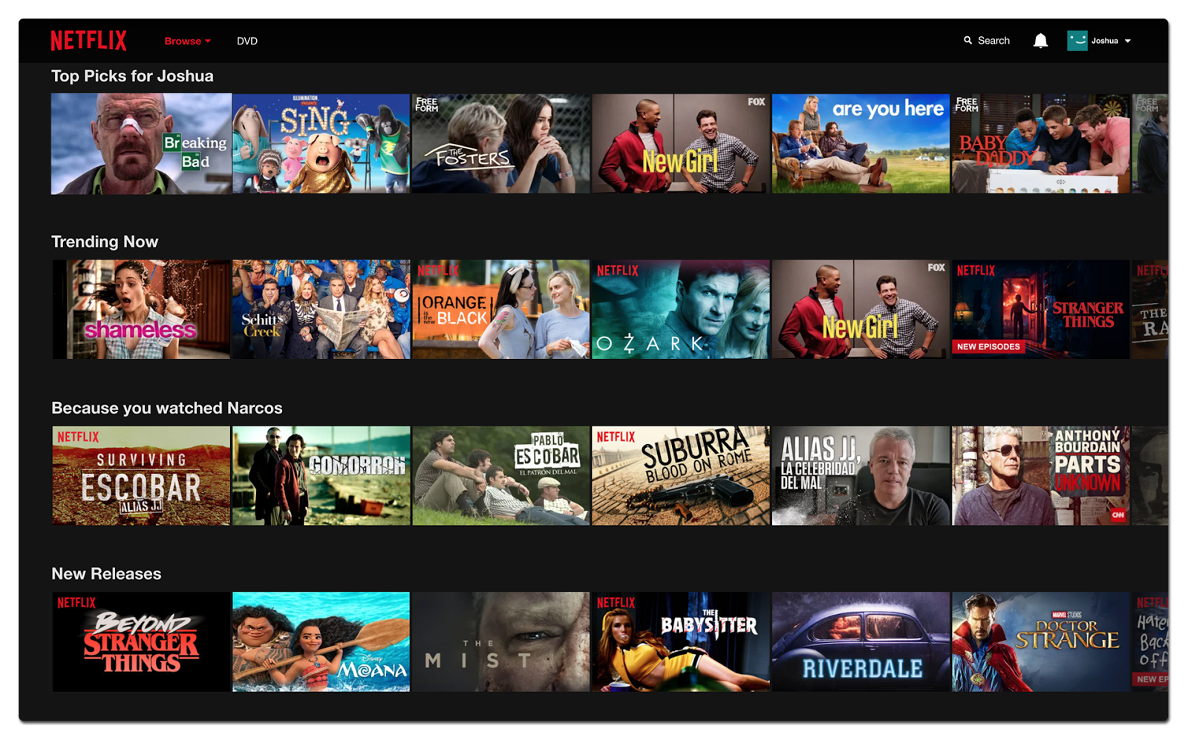

Slide 11
NetFlix EcoSystems
100s of Microservices
1000s of daily production changes
10,000s of cloud instances running at any point of time
100,000s of customer interaction per minute
1,000,000s of customers ( last record announce was 110 mil)
1,000,000,000s of time stream matrices

Slide 12
How NetFlix manages
Run by 80+ engineers
No Network Operation Center (NOC)
Run as Infrastructure-as-code

Slide 13
What does it mean?
In DevOps, both Development and Operation teams (or Infra and application teams) use the same set of tools
Operation team create and provide tools for Development team to consume
Standard environments. Dev, Test, UAT, QA and Prod could have standard deployment across environments
Main idea is to create stable, reliable, scalable and automated environment

Slide 14
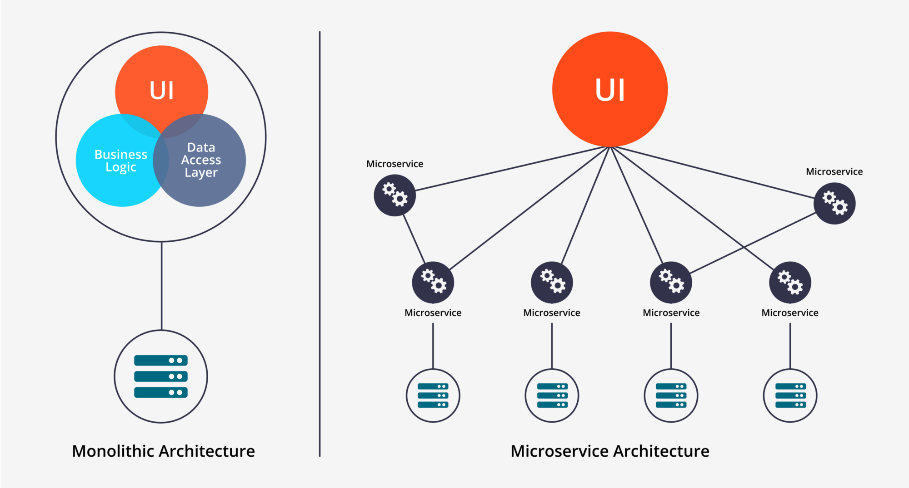

Slide 15
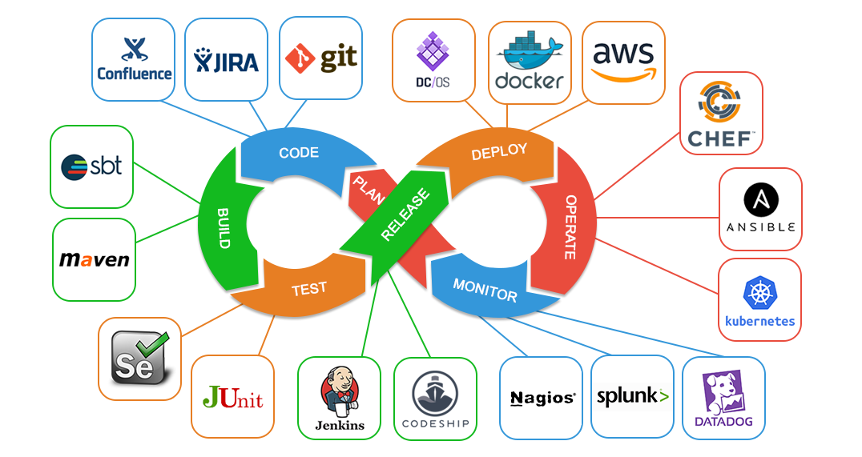

Slide 16
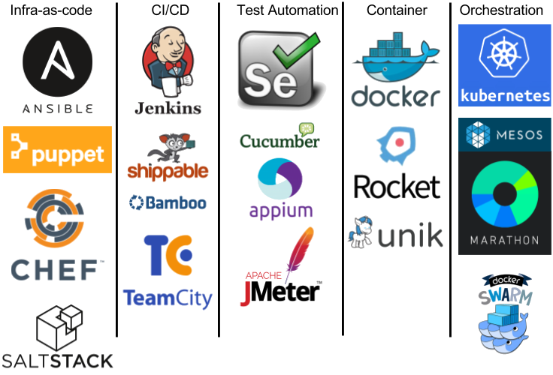

Slide 17
DevOps suitable for Every Organization?

Slide 18


Slide 19
Critical functions such as Healthcare or Core banking cannot be on DevOps. They still and will still run on super stable things like AS400 or mainframes.

Slide 20
Why DevOps is growing?
Every organization needs IT related initiatives and innovations
Complexities of Infra as well as applications are getting higher. Better end to end overview is required for strategic planning
Automation helps improve operational efficiency, which in tends save operational cost in long run

Slide 21
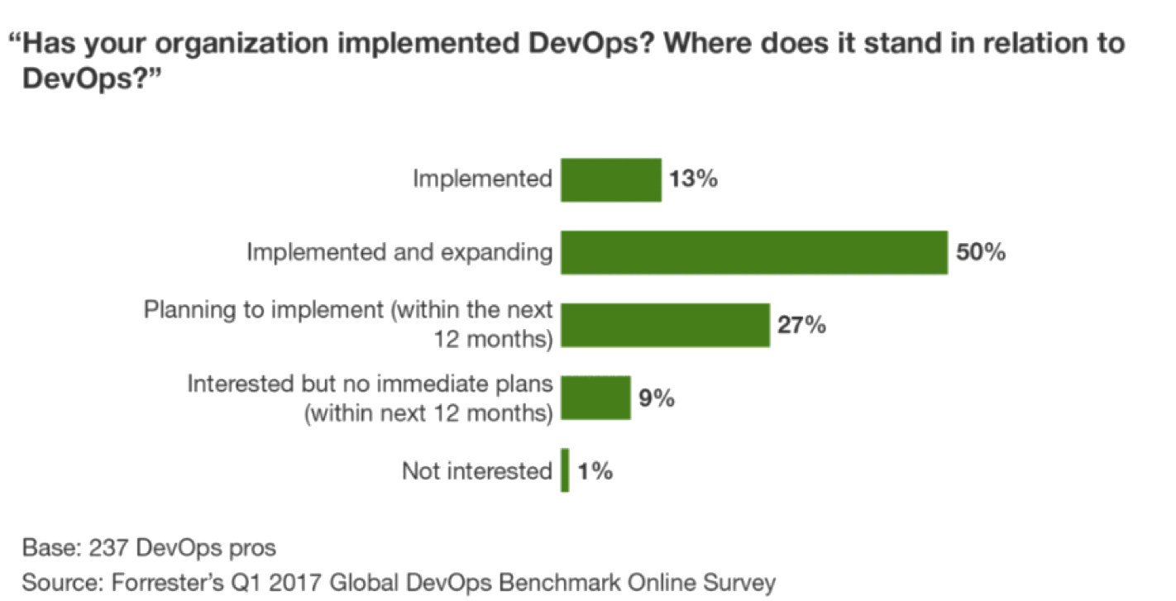
Organizations adopting DevOps? Really?

Slide 22


Why should I pick up DevOps?
Who knows Linux?
Who knows DevOps?
Image Credit: Edureka

Slide 23

Feel the Force in DevOps… You will…

Slide 24
Thank You!

